Slide 1
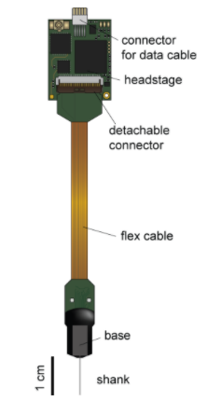
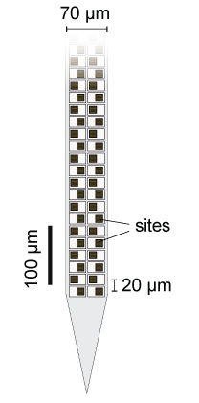
Neuropixel Probe
from https://github.com/cortex-lab/neuropixels/wiki
The part that goes into the cortex is the shank, 0.5-1cm long
Depending on the type
The shank has 960 sensors, but can only use 384 at a time,
So the user has to choose which sensors to use
The data is recorded on ‘channels’ of which there are 384
The sensors are arranged in a checkerboard pattern

Slide 2
For example, for phase 3A probe:
There are 4 columns of 240 sensors
40 um/2 sensors *240 sensors = 4800 micrometers of sensors + 200um
Distance from the end of the shank = 5000 um or 0.5 cm
Each probe can amplify and digitize the recorded
Signals
Neuropixel also offers spike sorting software

Slide 3
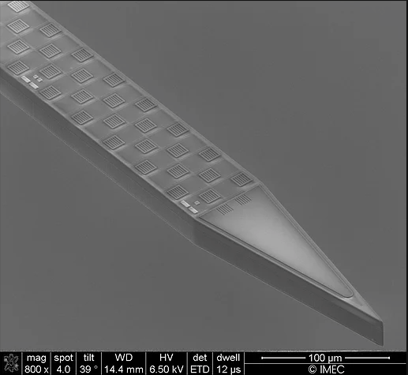
Multi-electrode array and position
Parameterize the location and orientation of the neuron relative to the multi-electrode array:
4 parameters (x, y, h, φ) for the cell’s location and orientation relative to the electrode. x, y are translation along x, y axes respectively. h is the height of the direction vector (projection on y-axis) corresponding to the elevation. φ is the azimuth angle (rotation about y-axis) of the direction vector.
All the 4 parameters have uniform prior distribution:
x: (0,200) μm, y: (-2000,2000) μm, h: (-1,1), φ: (0,π)
Layout and location of the electrode probe:
Layout of Neuropixel for in vivo recording: 4*96 2d-array.
Simulated probe: Average over every 4 electrodes, 96 1d-array.
Location: Centered at the origin. -1900 to 1900 μm along y-axis.

Slide 4
Getting started with sbi
Follow instructions in NeuroLabUsage.pdf
This includes getting a github account
Then getting an account with NeuroLab
Then creating an environment NeuroLab
Find the sbi folder in your environment on the server, and click on terminal on the desktop
Type ‘Jupyter-notebook’. This will open a notebook in firefox
In the notebook navigate to home->sbi->sbi->tutorials
Click on the first one
These tutorials come from https://www.mackelab.org/sbi/,
Where you can find more information about sbi

Slide 5
Bayesian inference provides a framework that clarifies this task. One wants to find the probability distribution, p(θ | x₀), known as the posterior, for a particular set of model parameters, θ, that reproduces the experimentally observed data, x_{0.} This probability can be related to the data one has previously collected, or simulated, though Bayes’ theorem: p(θ | x₀) = (p(x₀ | θ)p(θ)) / p(x₀). Each part of this equation pertains to a different aspect of the modeling process. p(x₀ | θ), known as the likelihood, is the probability that we observed our data x_{o} given that the underlying circuitry had parameters θ. p(θ), known as the prior, is the probability that the particular parameters would occur. Finally, p(x₀) is the probability that our specific experimental observation would occur. There are several benefits to this approach. We are not constrained to a single fitted model, but instead a distribution of models each weighted by how likely they are to produce the experimental data. Moreover, background information about the microcircuit properties, such as their natural range of values, can be incorporated into the prior. It is also computationally cheap once we know the likelihood that relates experimental observations to model parameters. But, calculating that likelihood, p(x₀ | θ), is computationally difficult. Likewise, finding the probability of our observed data, p(x₀), requires knowing all possible measurements that could have.

Slide 6
One way to overcome these problems is to use Approximate Bayesian Computation (ABC, Sisson et al. 2018). This approach does not seek to measure the exact probability of p(θ | x₀), but instead finds a function that is proportional and approximate to it. This is good enough, since we are only interested in finding the θ that best matches our data, not in knowing its exact probability. This means we do not have to calculate p(x₀), which is just a normalizing factor (CITE), leaving us to solve p(θ | x₀) ∝ p(x₀ | θ)p(θ). Since p(θ) is known from the background literature, the problem is now to find an approximation for the likelihood, p(x₀ | θ). The original approach was to simulate many models using parameters, θ, drawn from the prior distribution, p(θ) (Diggle and Gratton 1984). Models that fall within a certain distance of x₀ are kept, while those farther away are rejected. However, this approach is very sensitive to the distance threshold; too restrictive and we may never find a match, while too permissive will just reproduce prior assumptions, p(θ) (Sisson et al. 2018). To overcome this, one can fit a function that maps observations, x, to their distribution of parameters, θ, which would directly approximate the posterior, p(θ | x₀), our target. With this, we can find the distribution of model parameters that best fit our observations.

Slide 7
Advances in this fitting have been made recently using Mixture Density Networks (MDNs, Bishop 1994). These are neural networks that take a set of features as inputs, and map them on to a set of outputs that specify the shape of a probability distribution, in our case p(θ | x). Typically, the probability distribution is created by combining several multivariate gaussians, so the outputs of the network would be their weights, means, and covariance matrices. The training of this network is done in two steps, giving the algorithm the name sequential neural posterior estimation (SNPE, Lueckmann et al. 2017; Papamakarios and Murray 2016). The first step draws samples from the prior distribution p(θ), feeds them into the biophysical model, and gets the corresponding model outputs (e.g. voltage traces, summary statistics, etc). An MDN is then trained to associate the model output with its corresponding parameters, yielding an approximate posterior distribution p(θ | x). Now that we have a posterior in the form of the MDN, it is fed the experimentally observed data, x₀, and the posterior for the experimental data is returned, p(θ | x₀). The next step uses this posterior as the new prior, called a proposal prior, p_{r}(θ), and the process is rerun. This is done for several cycles until convergence.

Slide 8
SNPE exhibits a remarkable ability to home in on the parameters underlying biophysical phenomena. It can accurately infer the parameters of a Hodgkin-Huxley model based on a limited set of summary statistics, such as current-evoked spike counts and resting potential (Gonçalves et al. 2019). The MDN is also flexible in how its layers are specified, allowing one to use convolutional (good for spatiotemporal data), gated-recurrent unit (for time series), fully connected (for lists of summary statistics) network layers, or combinations of these, to best capture the mapping between the observed data and underlying biophysical model parameters.

Slide 9
Training deep neural density estimators to identify mechanistic models of neural dynamics

Slide 10
“Here we propose a new approach using machine learning to combine the advantages of mechanistic and statistical modeling. We present SNPE (Sequential Neural Posterior Estimation), a tool that rapidly identifies all mechanistic model parameters consistent with observed experimental data (or summary features). SNPE builds on recent advances in simulation-based Bayesian inference [36–39]: Given observed experimental data (or summary features) x_{o} , and a mechanistic model with parameters θ, it expresses both prior knowledge and the range of data-compatible parameters through probability distributions. It returns a posterior distribution p(θ/x_{o}) which is high for parameters θ consistent with both the data x_{o} and prior knowledge but approaches zero for θ inconsistent with either (Fig. 1). Similar to parameter search methods, SNPE uses simulations instead of likelihood calculations, but instead of filtering out simulations, it uses all simulations to train a multi-layer artificial neural network to identify admissible parameters (Fig. 1). By incorporating modern deep neural networks for conditional density estimation [40, 41], it can capture the full distribution of parameters consistent with the data, even when this distribution has multiple peaks or lies on curved manifolds. Critically, SNPE decouples the design of the model and design of the inference approach, giving the investigator maximal flexibility to design and modify mechanistic models. Our method makes minimal assumptions about the model or its implementation, and can e.g. also be applied to non-differentiable models, such as networks of spiking neurons.

Slide 11
Its only requirement is that one can run model simulations for different parameters, and collect the resulting synthetic data or summary features of interest.
We test SNPE using mechanistic models expressing key neuroscienti1c concepts. Beginning with a simple neural encoding problem with a known solution, we progress to more complex data types, large datasets and many parameter models inaccessible to previous methods. We estimate visual receptive 1elds using many data features, demonstrate rapid inference of ion channel properties from high-throughput voltage-clamp protocols, and show how Hodgkin–Huxley models are more tightly constrained by increasing numbers of data features. Finally, we explore how multiple network models can explain the activity in the stomatogastric ganglion [7], and provide hypotheses for which compensation mechanisms might be at play. Concurrently with our work, Bittner and colleagues [42] developed an alternative approach to parameter identification for mechanistic models, and showed how it can be used to characterize neural population models which exhibit specific emergent computational properties. Both studies differ in their methodology and domain of applicability (see descriptions of underlying algorithms in our [37, 38] and their [43] prior work), as well in the focus of their neuroscientific contributions, but they share the overall goal of using deep probabilistic inference tools to build more interpretable models of neural data. These complementary and concurrent advances will expedite the cycle of building, adjusting and selecting mechanistic models in neuroscience.”

Slide 12
Example case cell for Project – Parameters 1
X- position from the electrode
Y- position along the electrode
The simulated electrode is along the y axis,
The trunk is also along the y axis
Theta – angle about the?
H – elevation
Phi – angle about the z axis
Scale – changes the magnitude

Slide 13
Additional Notes
The 96 electrodes measuring the LFP are evenly spaced from -1900 to 1900 μm along the y-axis
Rotation then translation

Slide 14
Problem Statement: For the example case cell (slides 12-13), use the Notebook provided to come up with:
(i) the logic and steps to complete the inferences process, and
(ii) the code and specific routines to do the same. Also explain your choice of the parameters including density (for example maf, mdn,or nsf or others), hidden features, num_tranforms ,training batch size (if changed),posterior sampling batch size (if changed), sampling method (for example mcmc),and any other changes to the default parameters of the training algorithm, for example you may choose to change the learning rate , or use the prior in further rounds with use_combined_loss = True. See https://www.mackelab.org/sbi/reference/ for details you may want to change. Also note if you are using multi round or single round, and why.
iii) if you are using an embedded network (for example CNN as shown in their tutorial) explain your choice for the kernel size, number of input and output channels, and the reason for the architecture (pooling, padding, etc) and your choice of activation function (softmax, reLU, etc)
iv) finally, the results will be the parameters that you inferred. Since the ground truth was generated from a simulation, the algorithm should be able to find the parameters reliably. Code for visualizing the results has already been included.
Feel free to change the summary statistics, or use an embedded network, it does not have to be CNN.

